Slide 1

THE US ECONOMY:
REMARKABLY RESILIANT, SO FAR
Presented by:
Elliot F. Eisenberg, Ph.D.
President: GraphsandLaughs, LLC
Roseville, IL
July 21, 2025

Slide 2
The Economy Surprises
GDP = C+I+G+(X-M)

Slide 3
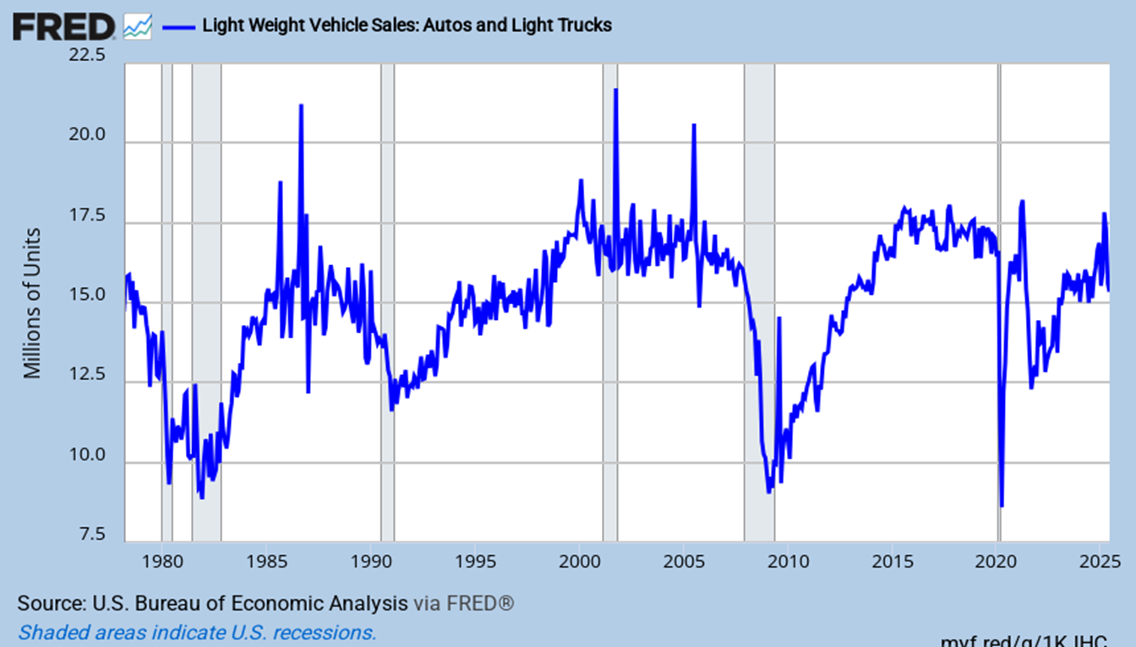
US Light Vehicle Sales
Car sales are light at 15.3 million/year
Notes:
Updated 7-7-25. Monthly data. ALTSALES (PERMANENT) TOTALSA = all car sales.
Comes out 1 or 2 days after carmakers report results.

Slide 4
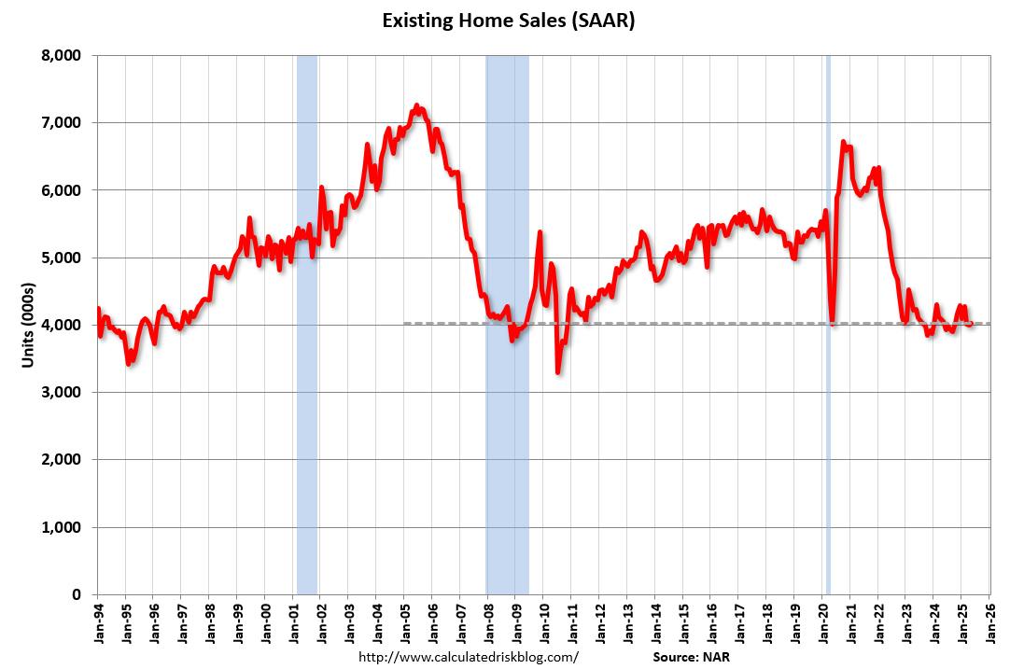
Existing Home Sales Are Soft
They rise in 2025 as rates fall, inventory rises, and sellers must sell
Notes:
Updated 6/23/25. NAR monthly data. EXHOSLUSM495S (PERMANENT). To get single-family data look at EXSFHSUSM495S. (existing home sales)
Comment 10-19-23

Slide 5
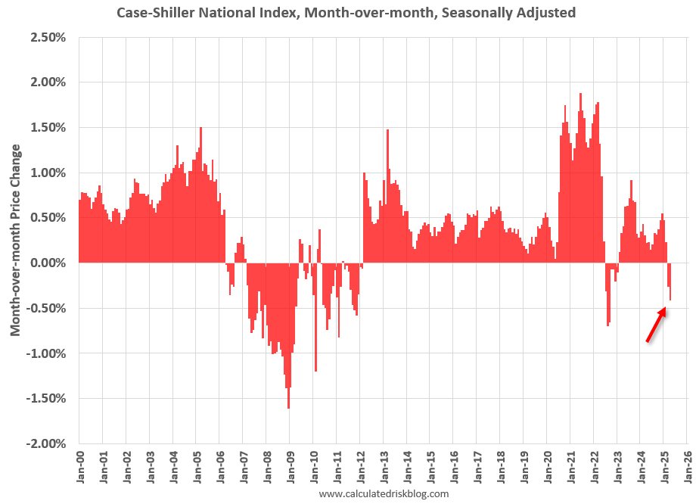
Case-Shiller M-o-M Price Changes
House price appreciation has reversed
Notes:
Updated 6-24-25 CalculatedRisk Blog
https://calculatedrisk.substack.com/p/case-shiller-national-house-price-9e9

Slide 6
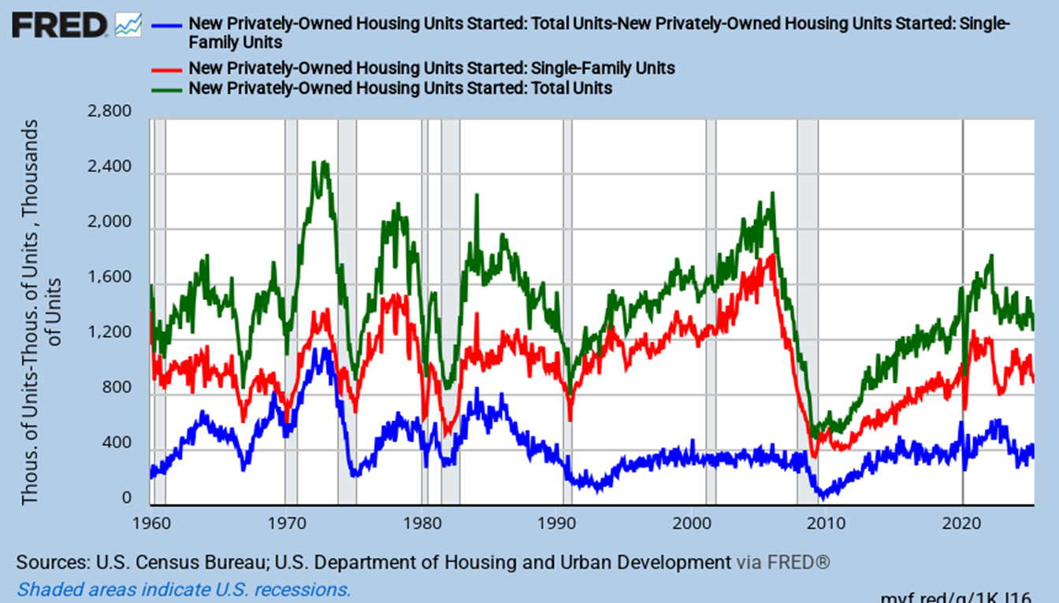
Single-Family and Multifamily Starts
SF starts struggle, MF starts are improving
Notes:
Update 7-18-25. Monthly data. HOUST, HOUST1F (PERMANENT)

Slide 7
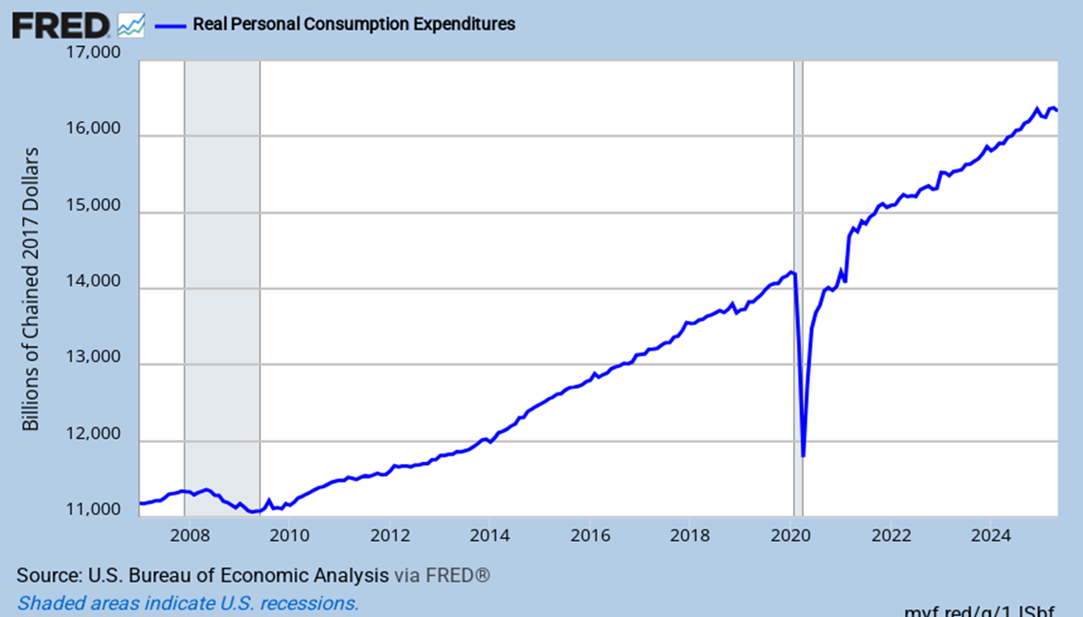
Real Personal Consumption Expenditures
It remains largely on trend, but of late is weaker
Notes:
Updated 6-27-25. Monthly data. PCEC96 (PERMANENT) (RRSFS)

Slide 8
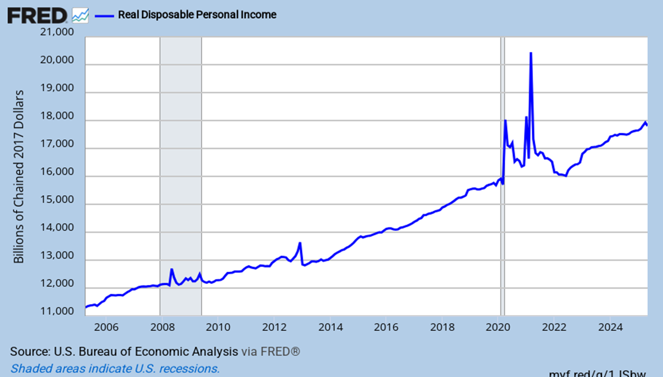
Real Disposable Personal Income
It is well above pre-Covid, but slightly below trend
Notes:
Updated 6-27-25. Monthly data. DSPIC96 (PERMANENT)

Slide 9
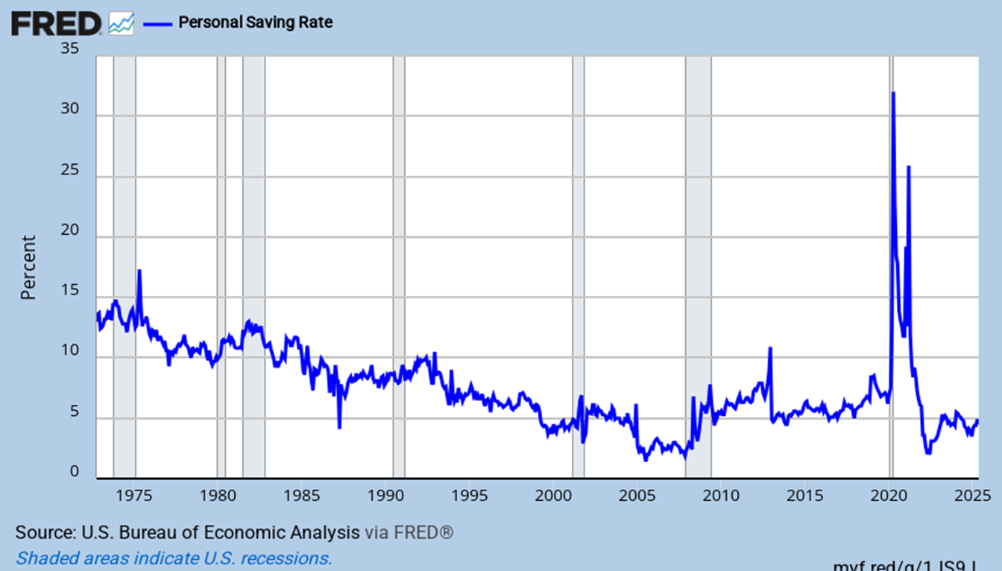
Household Savings Rate
It is improving but still low at 4.5%
Notes:
Updated 6-27-25. Monthly data. PSAVERT (PERMANENT) Also look at A072RC1Q156SBEA = savings as % of disposable income.
Comment 6-27-25.

Slide 10
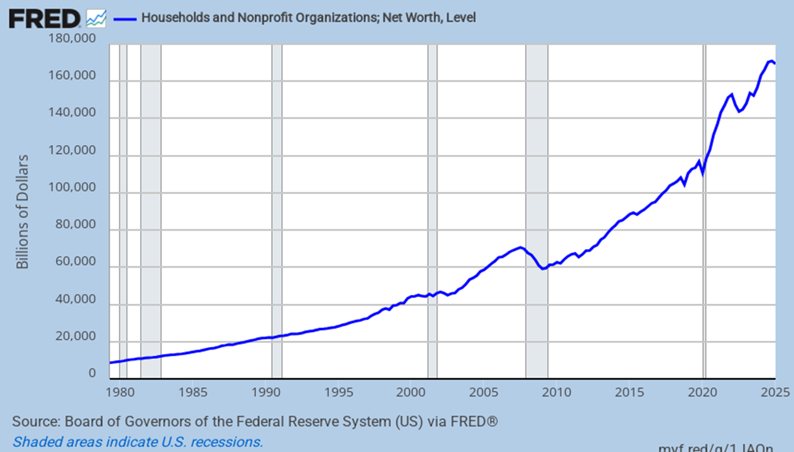
Household Balance Sheets
Growth in net worth had been excellent through 24Q3
Notes:
Updated 6-12-25. Updated quarterly. TNWBSHNO (PERMANENT) (Household net worth, networth, Household wealth)

Slide 11
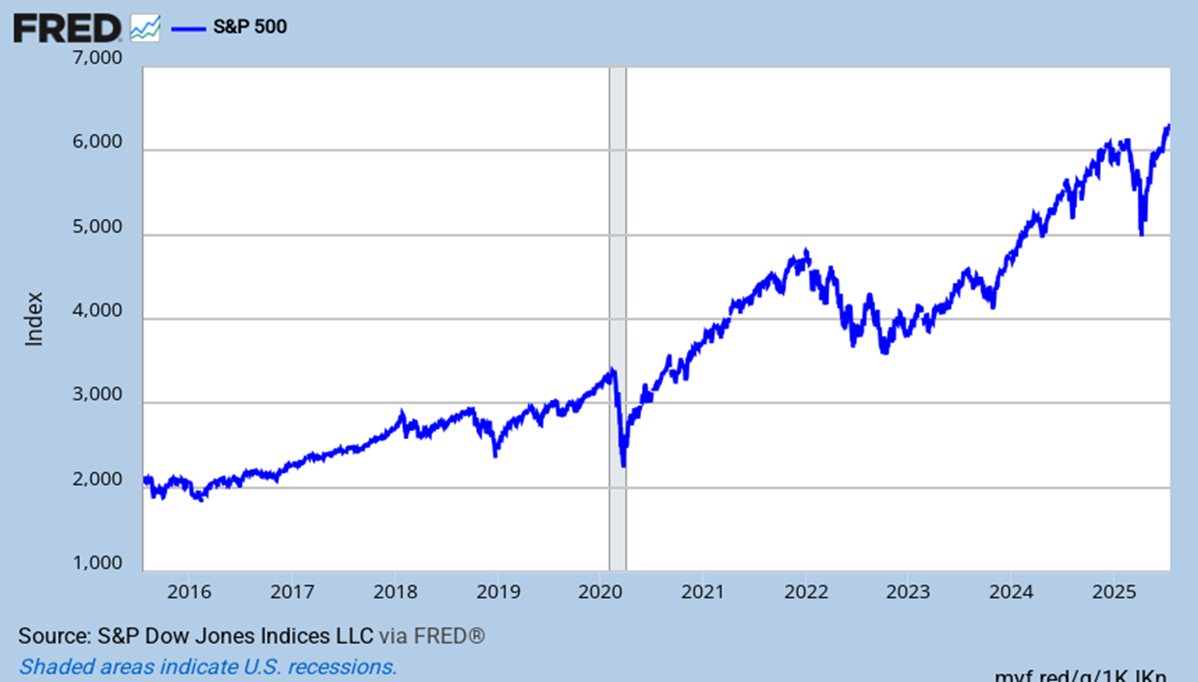
The Stock Market Rebounds
Lower rate expectations, strong corporate profits, strong AI spending
Notes:
Updated 7-18-25. Daily data. SP500 (PERMANENT)

Slide 12
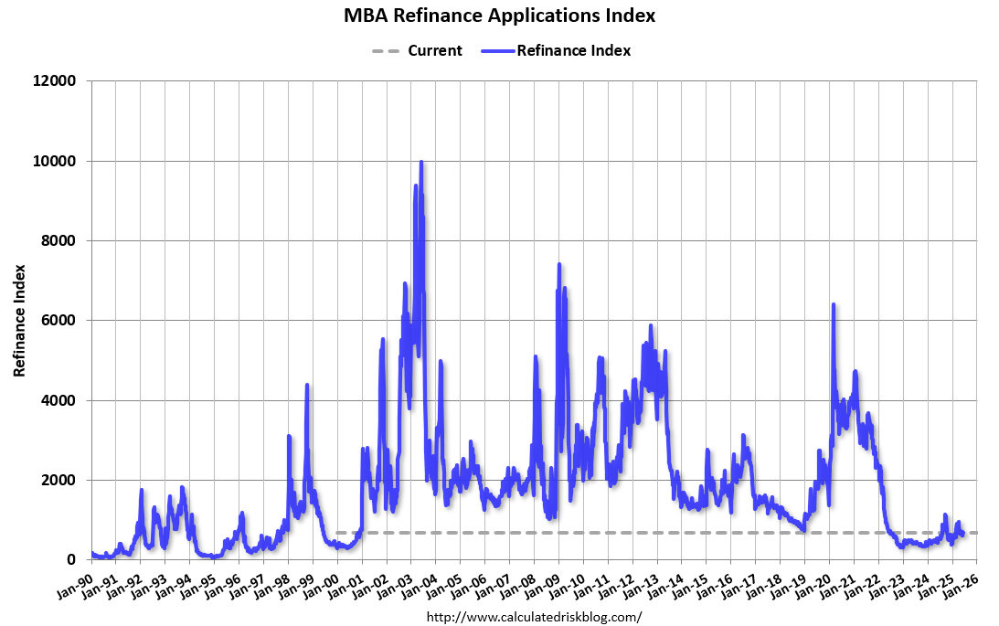
Refinance Activity Is Slightly Better
Refi was $220 billion in ‘23, $490 billion in ’24, and maybe $650 billion in 2025
Notes:
Updated 6-18-25. Weekly (MBA Refinance applications index)
Comment 4-9-25.
Refi was $2.6 trillion in ‘21, $686 billion in ‘22, $219 billion in ‘23, maybe $491 billion in ‘24

Slide 13
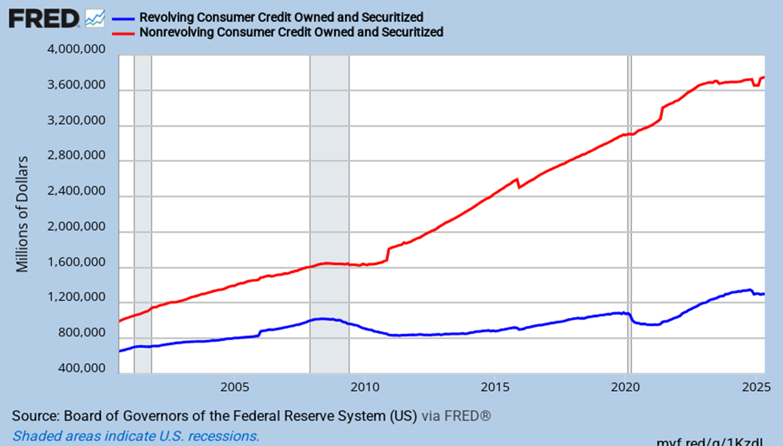
Non-Revolving Credit Growth Slows
Revolving credit growth is weak and is now declining
Non-Revolving Credit
Credit Card Balances
Notes:
Updated 7-8-25. Monthly data. NONREVSL (PERMANENT)

Slide 14
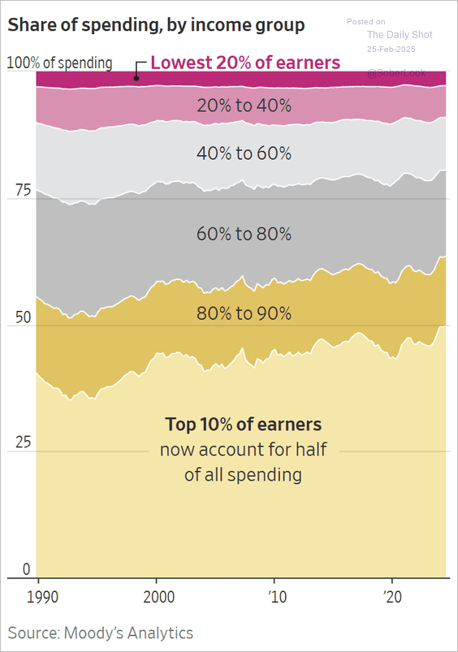
Consumer Spending Since 1990
The top 10% are driving spending
Notes:
Updated 2/25/25. The WSJ (US Consumer spending)
https://www.wsj.com/economy/consumers/us-economy-strength-rich-spending-2c34a571

Slide 15
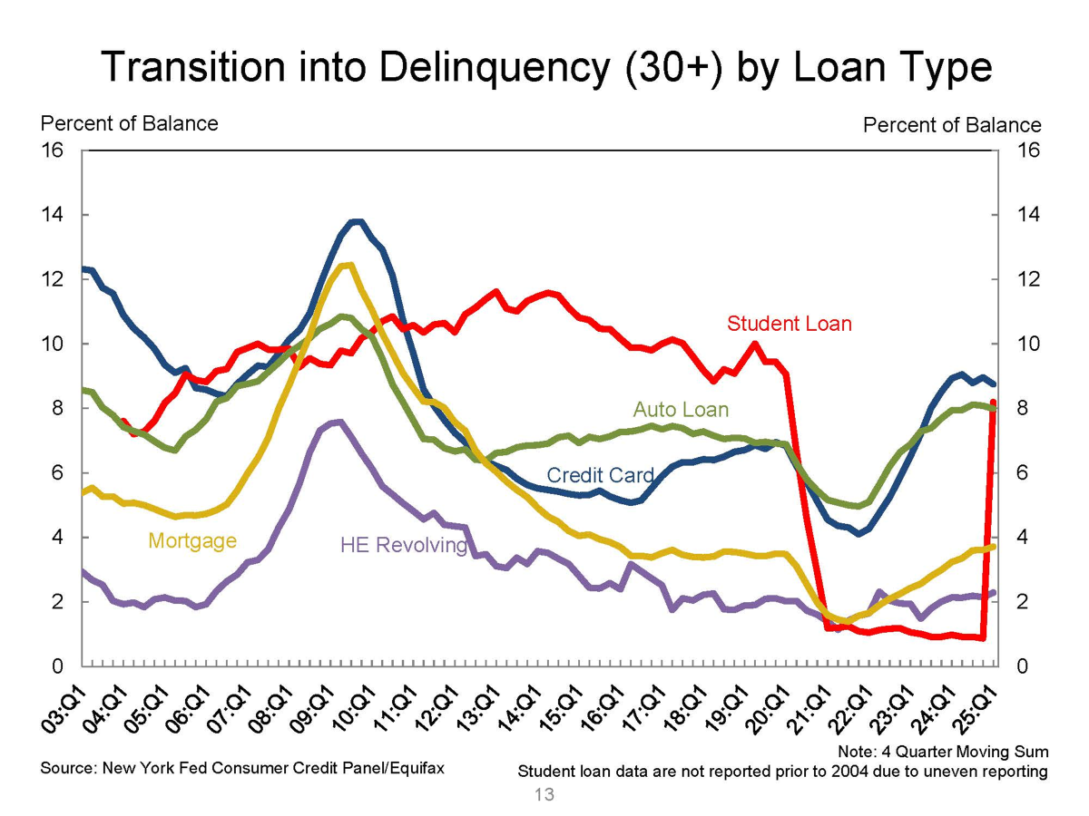
Percent of Balance 30+ Days Delinquent
Most loan types now show deterioration
Notes:
Updated 5-13-25. Quarterly data. NY Fed. Quarterly Report on Household Debt and Credit August 2022 (Transition into Delinquency (30+) by loan type)
https://www.newyorkfed.org/medialibrary/interactives/householdcredit/data/pdf/HHDC_2025Q1
https://www.newyorkfed.org/microeconomics/hhdc.html
Transition into

Slide 16
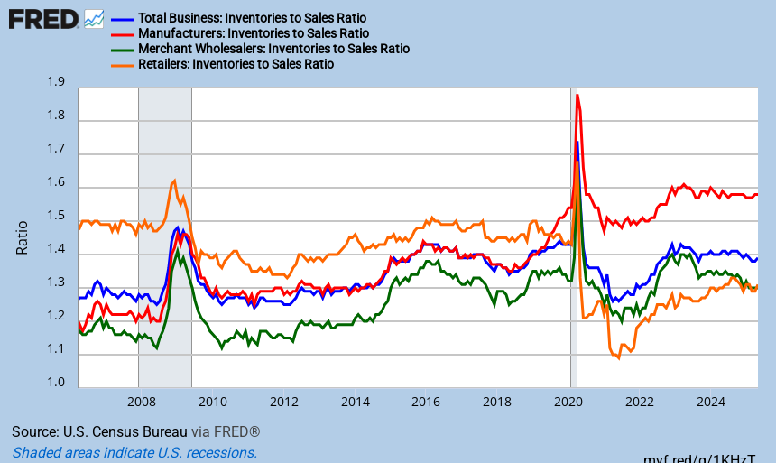
Inventory to Sales Ratios
Retail inventories are flat and below their pre-covid level
Notes:
Updated 7-17-25 ISRATIO, MNFCTRIRSA, WHLSLRIRSA, RETAILIRSA. Monthly data (PERMANENT)
Comment 7-17-25.

Slide 17
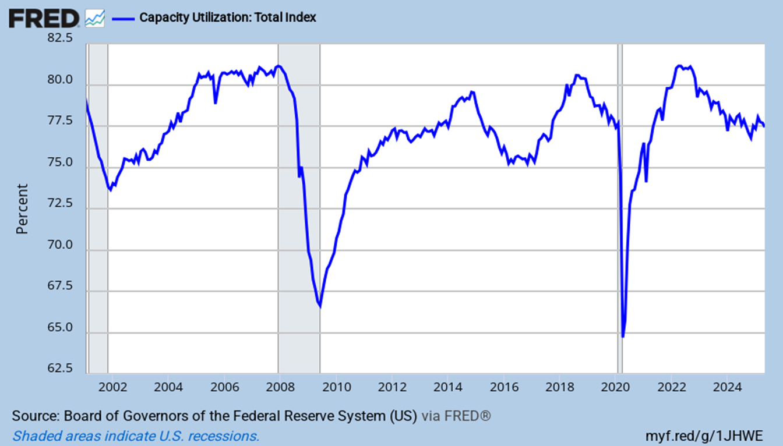
Capacity Utilization Rates
Well below pre-Covid levels, and again declining
Notes:
Updated 6-17-25 Monthly data. TCU (PERMANENT)

Slide 18
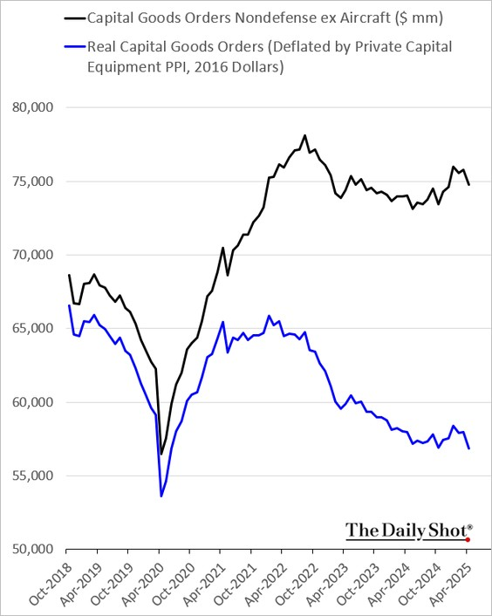
Real Capital Goods Orders
Firms are investing in IP. Think software and AI, but not much else
Notes:
Updated 5-28-25. The Daily Shot NEWORDER (PERMANENT). (Real capex NEFA ELFA, signal insurance)

Slide 19

Trump is the 47th President
As for his major economic policies…
Energy
Deregulation
Tax cuts & extensions
Immigration reform
Tariffs / Trade policy
Notes:
Updated 11-10-24

Slide 20
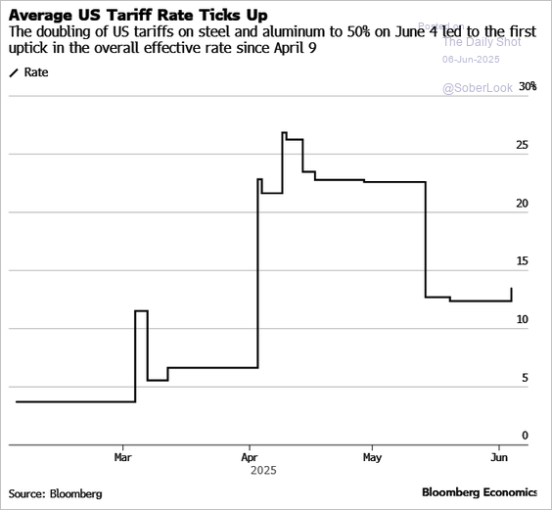
Average US Effective Tariff on Imported Good
Rates are higher and variable
Notes:
Updated 6-6-25 The Daily Shot (average tariff, US average tariff rate, US effective tariff rate, US tariffs, Smoot-Hawley)

Slide 21
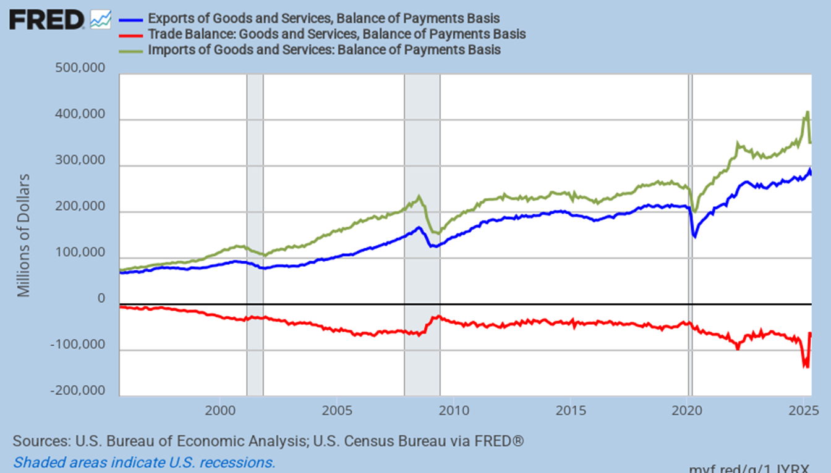
The Trade Deficit
Tariff frontrunning driven the deficit way up and then down
Notes:
Updated 7-3-25. Monthly Data. BOPTEXP, BOPGSTB, BOPTIMP. (PERMANENT) Looking at BOPGSTB alone is good too.

Slide 22
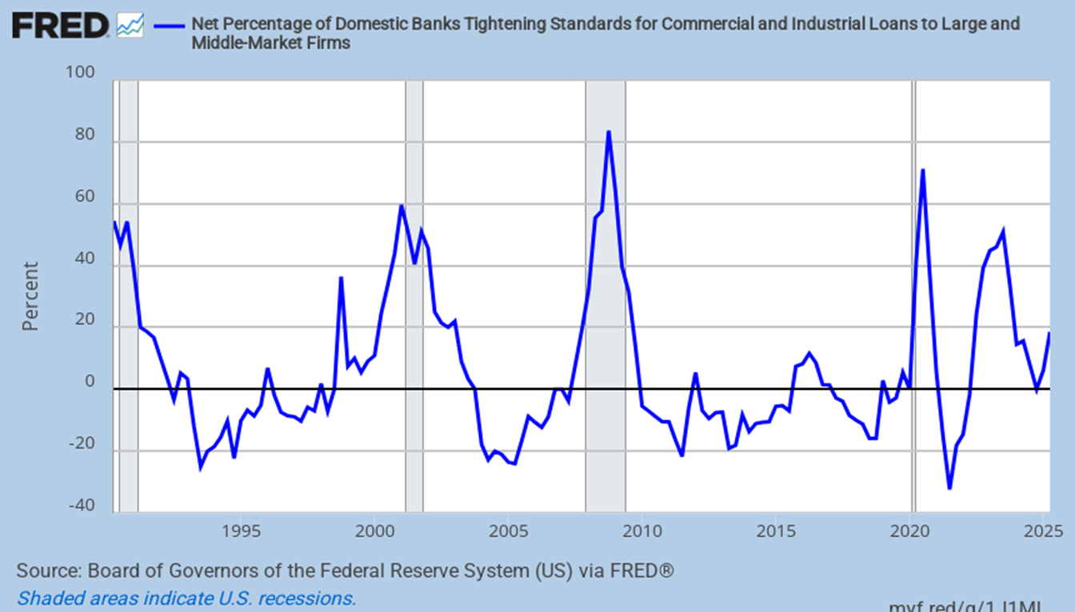
Banks are Tightening Lending C&I Loan Standards
Since the start of 2025 standards are higher
Notes:
Updated 5-12-25 Quarterly data Clockwise from top left, DRSDCILM DRSDCIS, DRTSCIS, DRTSCILM (PERMANENT) (SLOOS, commercial and industrial loans, commercial & industrial loans)

Slide 23
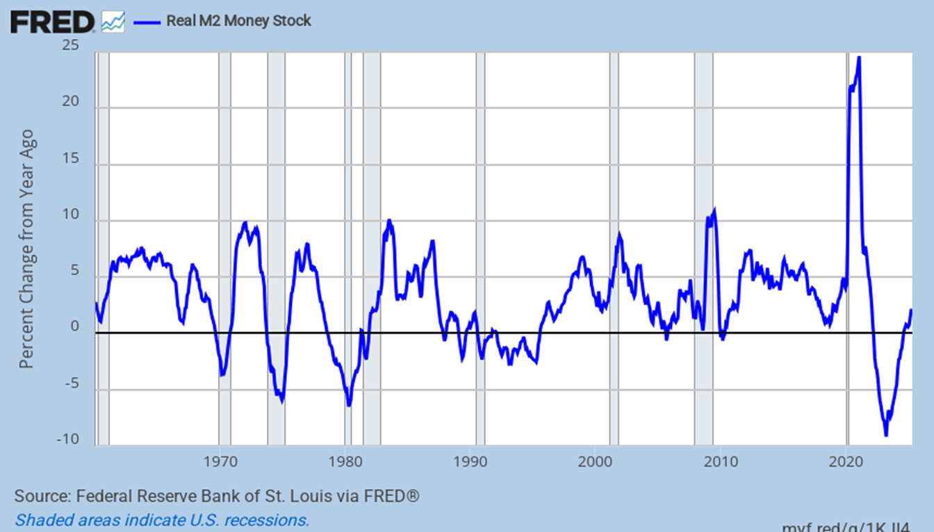
The Monetary Supply
It is again growing
Notes:
Updated 6-24-25. The Daily shot M2REAL (Permanent)

Slide 24
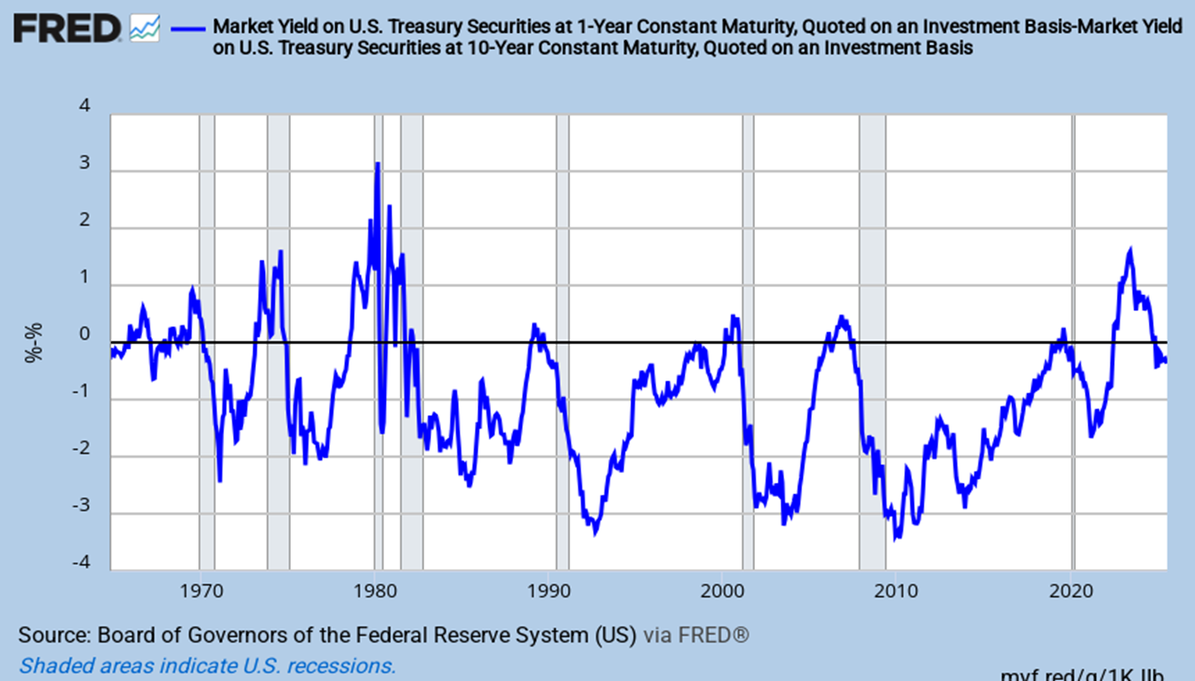
The Yield Curve is Barely Normal
1-Year Treasury Yield – 10-Year Treasury Yield. 1yr should fall more
Notes:
Updated 7-17-25. Updated monthly. DGS1, DGS10 (PERMANENT)

Slide 25
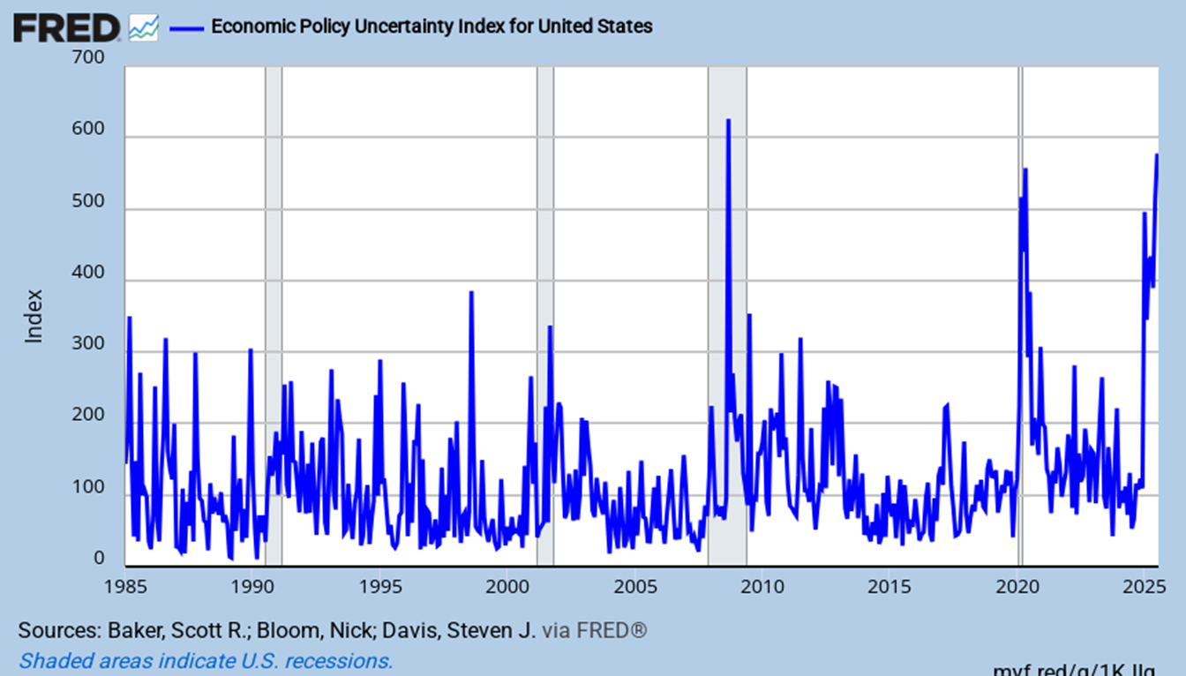
US Economic Policy Uncertainty
It’s quite elevated
Notes:
Updated 7-17-25. Daily data. (Weekly) USEPUINDXD (PERMANENT) Baker, Bloom and Davis.
https://www.policyuncertainty.com/

Slide 26
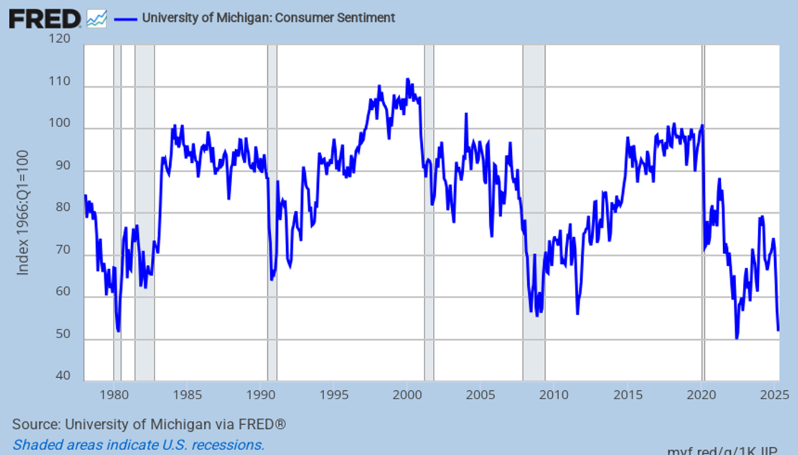
University of Michigan Consumer Sentiment Index
DOGE cuts, tariffs, inflation, higher rates, reduced net immigration and job cuts
Notes:
Updated 6-27-25 UMCSENT (PERMANET) (university of Michigan consumer sentiment, U of Mich, )

Slide 27
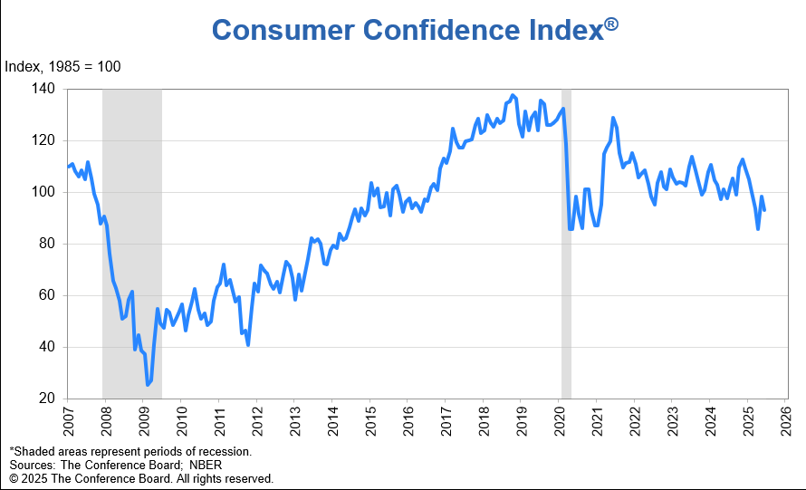
Conference Board Consumer Confidence
Confidence has noticeably declined
Notes:
Updated 6-24-25. The Daily Shot. (conference board consumer confidence)
https://www.conference-board.org/topics/consumer-confidence

Slide 28
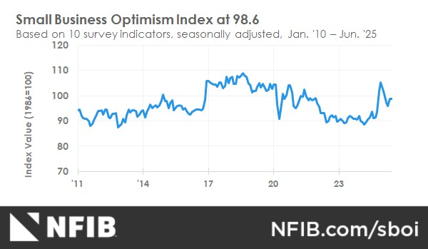
Small Business Confidence
It’s above its 51-year average of 98. The Trump bump is recovering
Notes:
Updated 7-8-25. Monthly Data. https://www.nfib.com/surveys/small-business-economic-trends/
Comment 4-8-25. NFIB
January 2016 sample size n=10,799, responses = 1,438, 13% response rate.

Slide 29
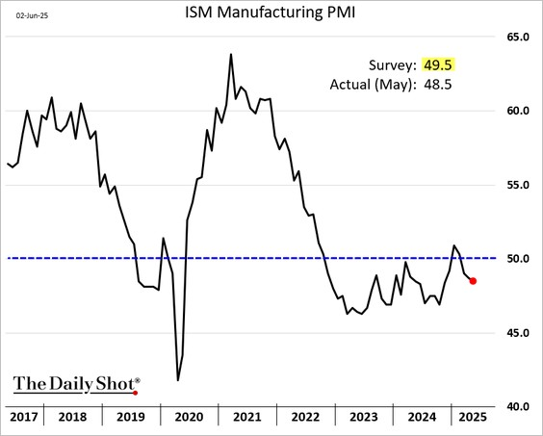
ISM Manufacturing Index
Manufacturing has been in a long recession
Notes:
Updated 6-3-25. The Daily Shot
This index tends to look at larger multinationals and not small and mid-sized domestic firms.

Slide 30
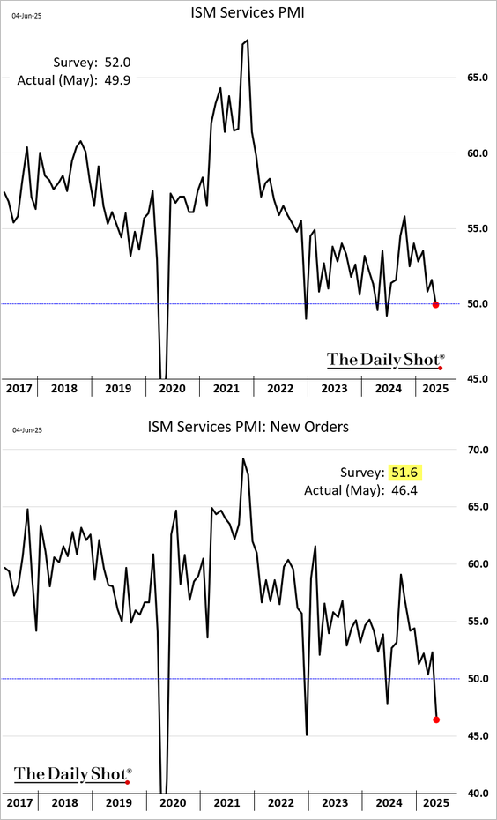
ISM Services
This is worrying
Notes:
Updated 6-5-25. The Daily Shot (ISM services PMI)

Slide 31
Labor Markets:
They are Softening

Slide 32
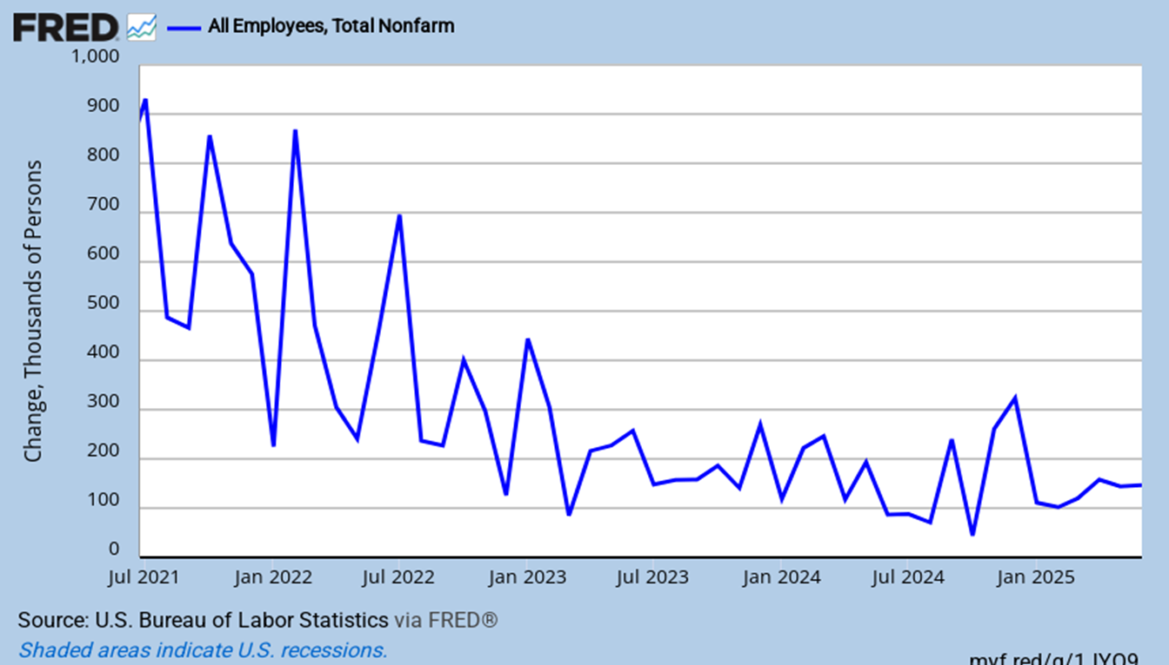
Historical Job Growth
It is lower but has stabilized
Notes:
Updated 7-3-25. Monthly data. PAYEMS (PERMANENT)

Slide 33
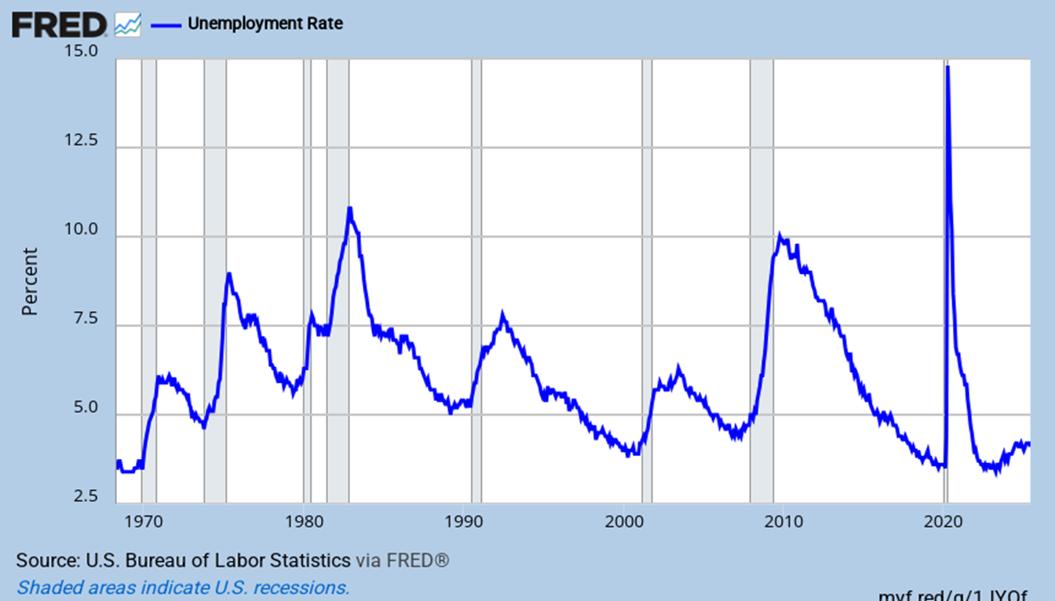
The Unemployment Rate
The rate is low and stable at 4.1%
Notes:
Updated 7-3-25. Monthly Data. UNRATE (PERMANENT): See Unemployment Rate: 16 to 24 years, and so on.

Slide 34
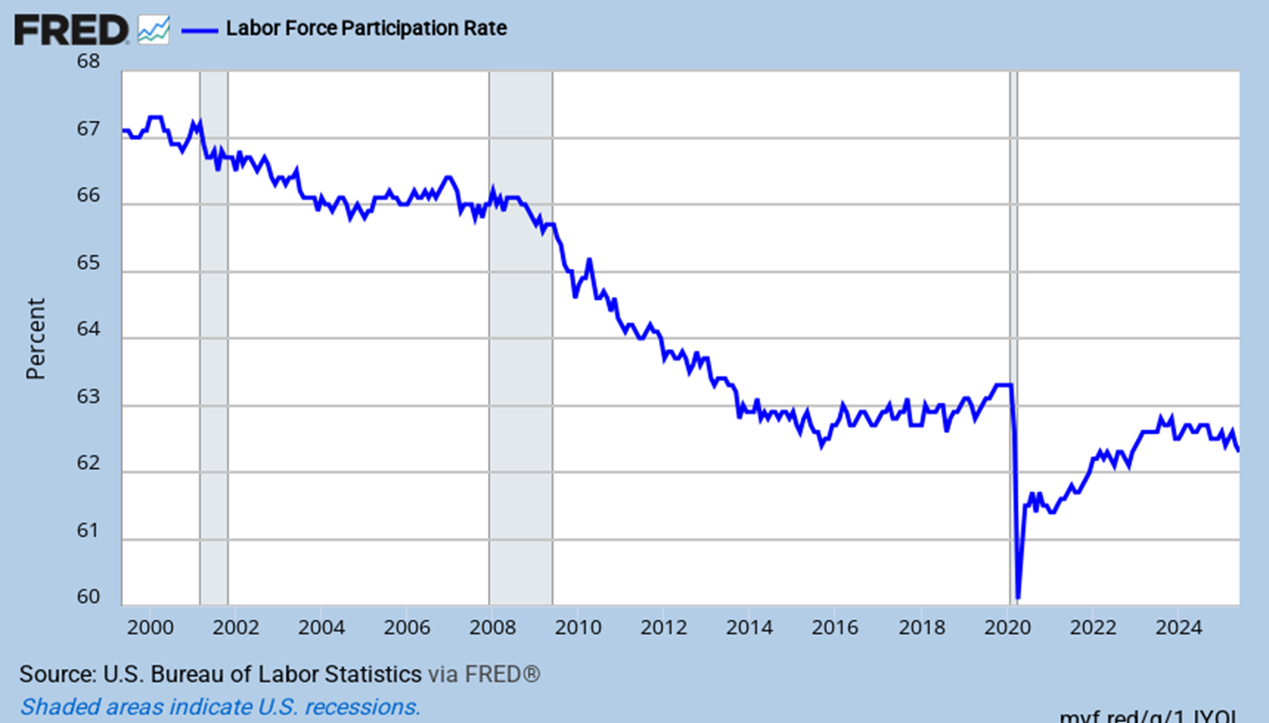
The Labor Force Participation Rate
Is slowly declining as the nation ages
Notes:
Updated 7-3-25. Monthly data. CIVPART (PERMANENT)

Slide 35
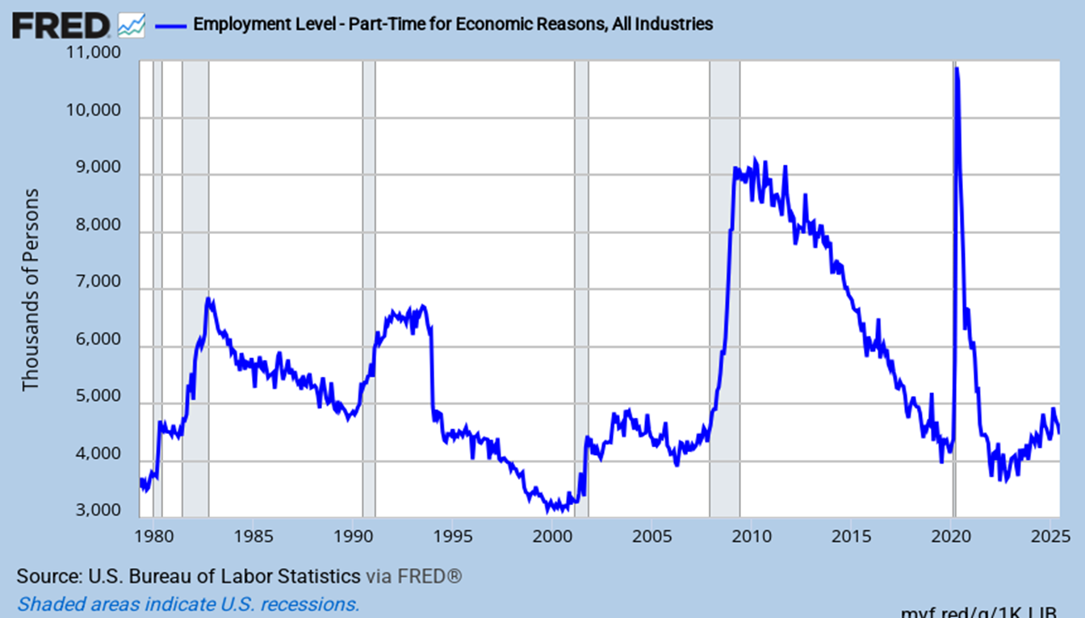
Working Part Time and Unhappy About It!
It is clearly rising
Notes:
Updated 7-3-25. LNS12032194 Monthly data. (PERMANENT)
Part-time for economic reasons

Slide 36
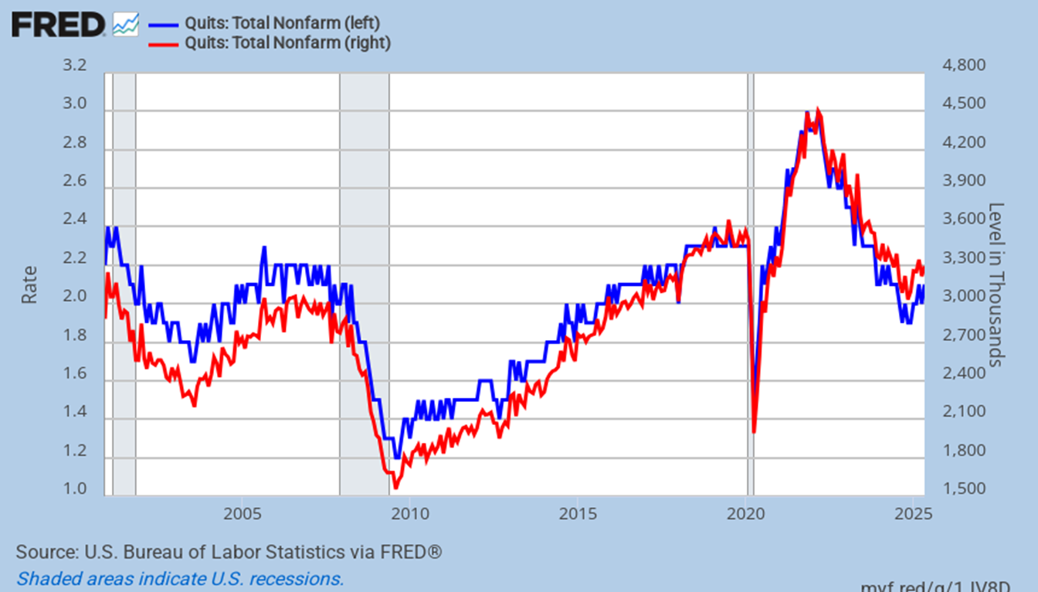
Quit Rates
Workers were quitting in droves, but much less so now
Notes:
Updated 7-1-25. Monthly data. JTSQUR, JTSQUL (PERMANENT) Job Openings and Labor Turnover Survey News Release (JOLTS)
Job separation data. Quits/job separations and layoffs/job separations are approaching 60% and 35% respectively; normal pre-recession levels. Comment 11-7-17.
ccsa

Slide 37
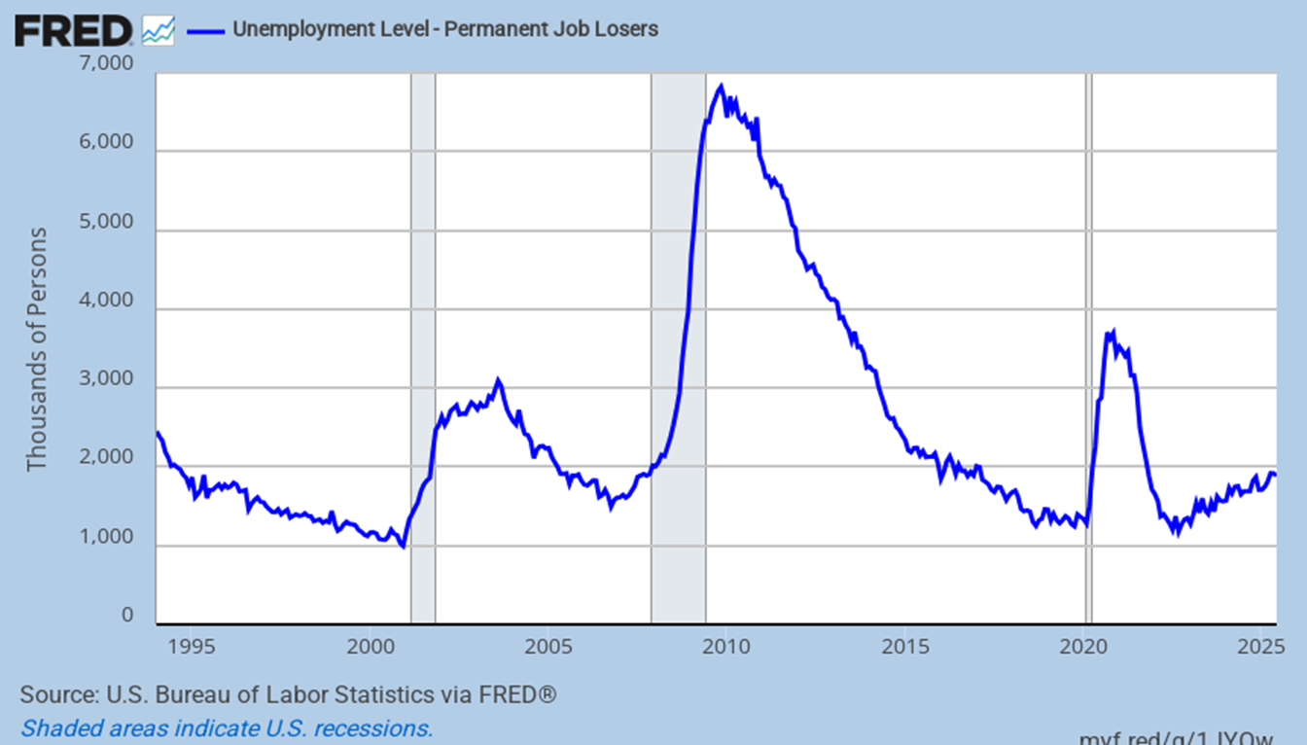
The Number of Permanent Job Losses
It is clearly rising
Notes:
Updated 7-3-25. Monthly Data. LNS13026638 (PERMANENT) (Permanent job losses)

Slide 38
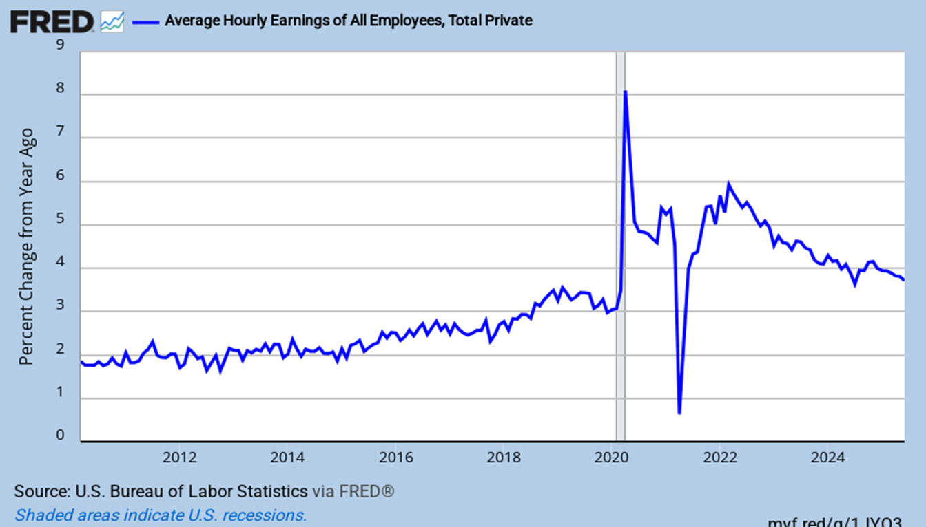
Y-o-Y Percent Change in Hourly Earnings
Wage growth is clearly weakening
Notes:
Updated 7-3-25. Monthly data. CES0500000003 (PERMANENT). (Can also look at Business Sector: Unit Labor Cost (ULCBS))
See also FRB ATL Wage Tracker https://www.frbatlanta.org/chcs/wage-growth-tracker.aspx?panel=1

Slide 39
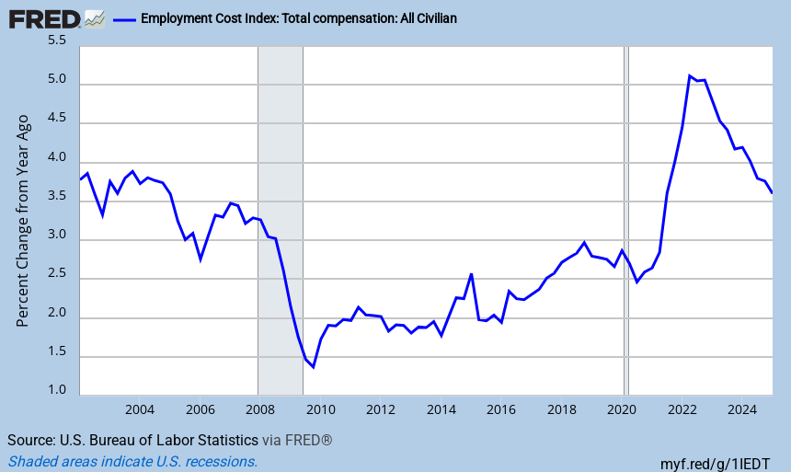
Total Compensation: It’s Falling but Still High
This measure includes bonuses
Notes:
Updated 4-30-25. Quarterly data. ECIALLCIV (PERMANENT) also see FRB Atlanta Wage Growth Tracker. (Employment cost index)
Comment 1-31-25

Slide 40
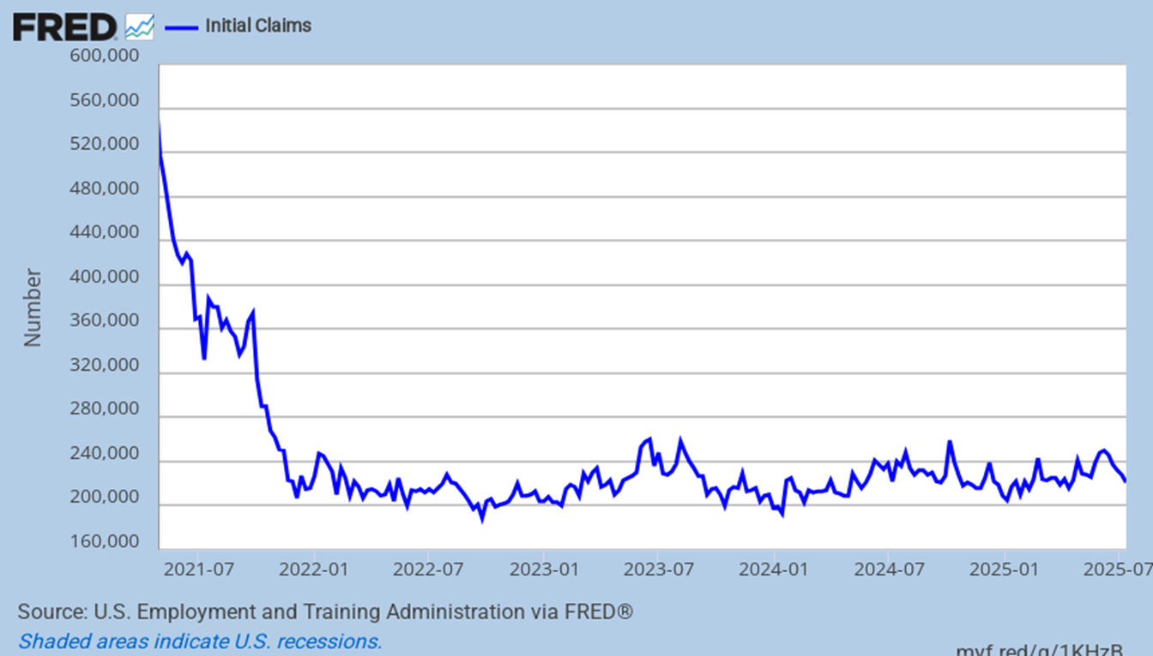
Involuntary Separations
Claims remain very low but are rising of late
Notes:
Updated 7-17-25. Weekly data. ICSA (PERMANENT)

Slide 41
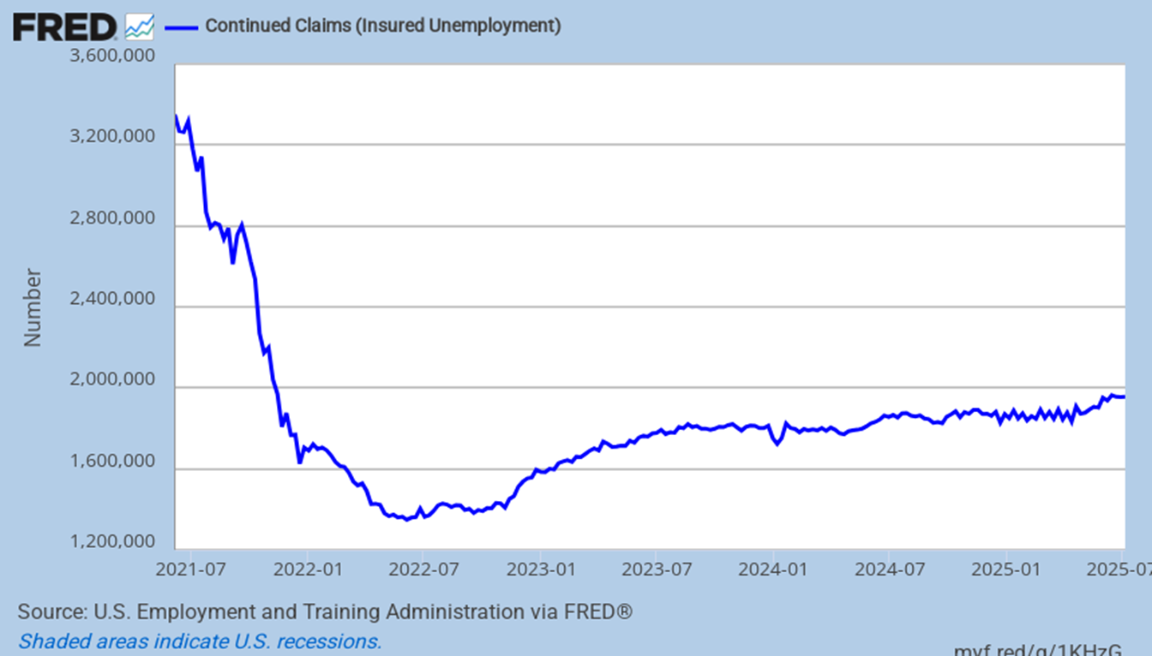
Continuing Unemployment Claims
It appeared to plateau but is now clearly rising
Notes:
Updated 7-17-25. Weekly data. CCSA (PERMANENT) JPG problem exists.

Slide 42
Inflation &
The Fed

Slide 43
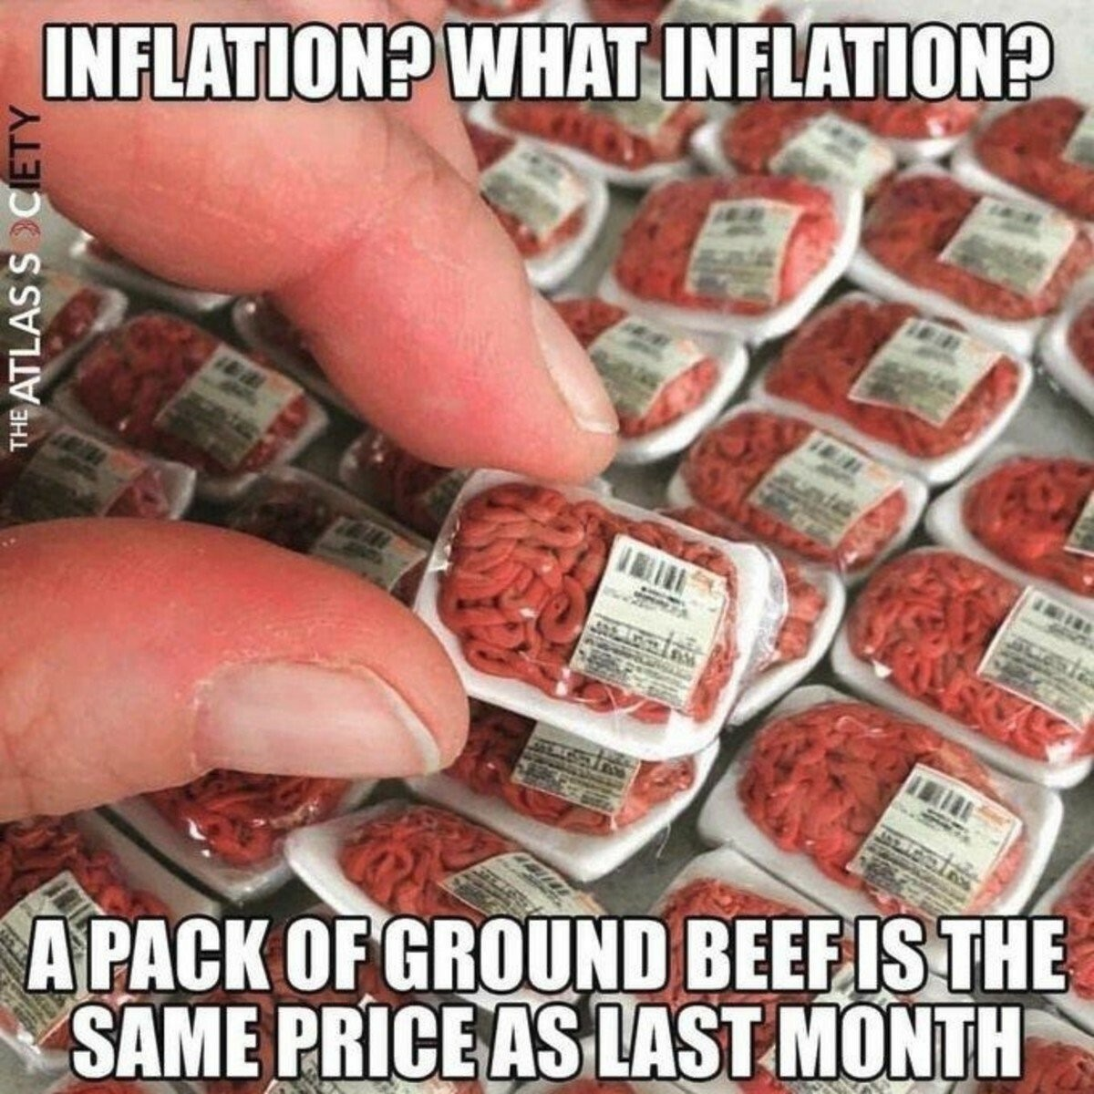
Notes:
Updated 1-12-22. Sent by Rob Chrisman

Slide 44
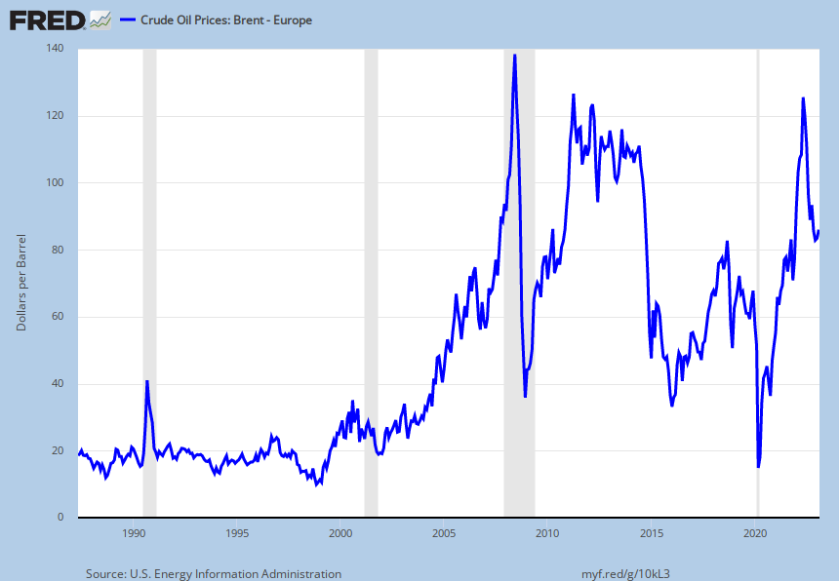
Oil Prices Flatten
This tells us that global supply is satisfactory
Notes:
Updated 2-15-23. Daily data. DCOILBRENTEU (PERMANENT)

Slide 45
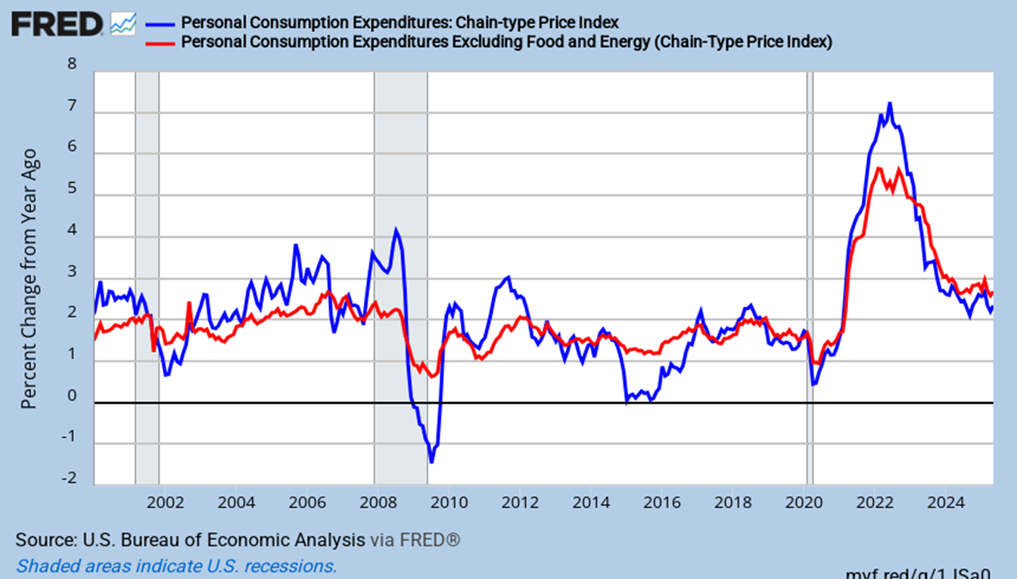
PCE and Core PCE Price Index
Focus on core (red) inflation
Notes:
Updated 6-27-25. Monthly data. PCEPI, PCEPILFE PCEPI (PERMANENT)

Slide 46
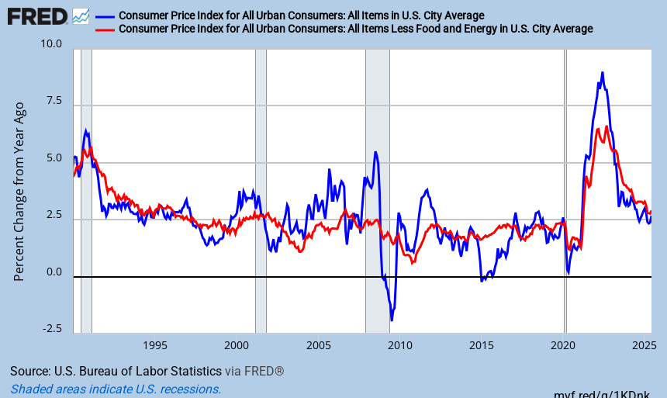
CPI: Inflationary Pressures
Are inflationary pressures rising?
Notes:
Updated 7-15-25. Monthly Data. CPIAUCSL CPILFESL (PERMANENT)

Slide 47
Federal Reserve Behavior
Most likely scenario
On 7/31/24 it was 5.375%
On 9/18/24 it finally fell to 4.875%
On 11/7/24 it unexpectedly fell to 4.625%
On 12/18/24 it surprisingly fell to 4.375%
Fed funds will fall further
Notes:
Updated 3-2-25

Slide 48
What About Things Here?

Slide 49
States Growing the Fastest
7/1/23-6/30/24
Rank | Geographic Area | April 1, 2020 (Estimates Base) | July 1, 2023 | July 1, 2024 | Percent Growth
Source: U.S. Census Bureau, Vintage 2024 Population Estimates.
1 | District of Columbia | 689,545 | 687,324 | 702,250 | 2.2%
2 | Florida | 21,538,192 | 22,904,868 | 23,372,215 | 2.0%
3 | Texas | 29,149,458 | 30,727,890 | 31,290,831 | 1.8%
4 | Utah | 3,271,608 | 3,443,222 | 3,503,613 | 1.8%
5 | South Carolina | 5,118,252 | 5,387,830 | 5,478,831 | 1.7%
6 | Nevada | 3,105,595 | 3,214,363 | 3,267,467 | 1.7%
7 | Idaho | 1,839,140 | 1,971,122 | 2,001,619 | 1.5%
8 | North Carolina | 10,441,499 | 10,881,189 | 11,046,024 | 1.5%
9 | Delaware | 989,955 | 1,036,423 | 1,051,917 | 1.5%
10 | Arizona | 7,158,110 | 7,473,027 | 7,582,384 | 1.5%
Notes:
Updated 12-19-24
https://www.census.gov/newsroom/press-releases/2024/population-estimates-international-migration.html

Slide 50
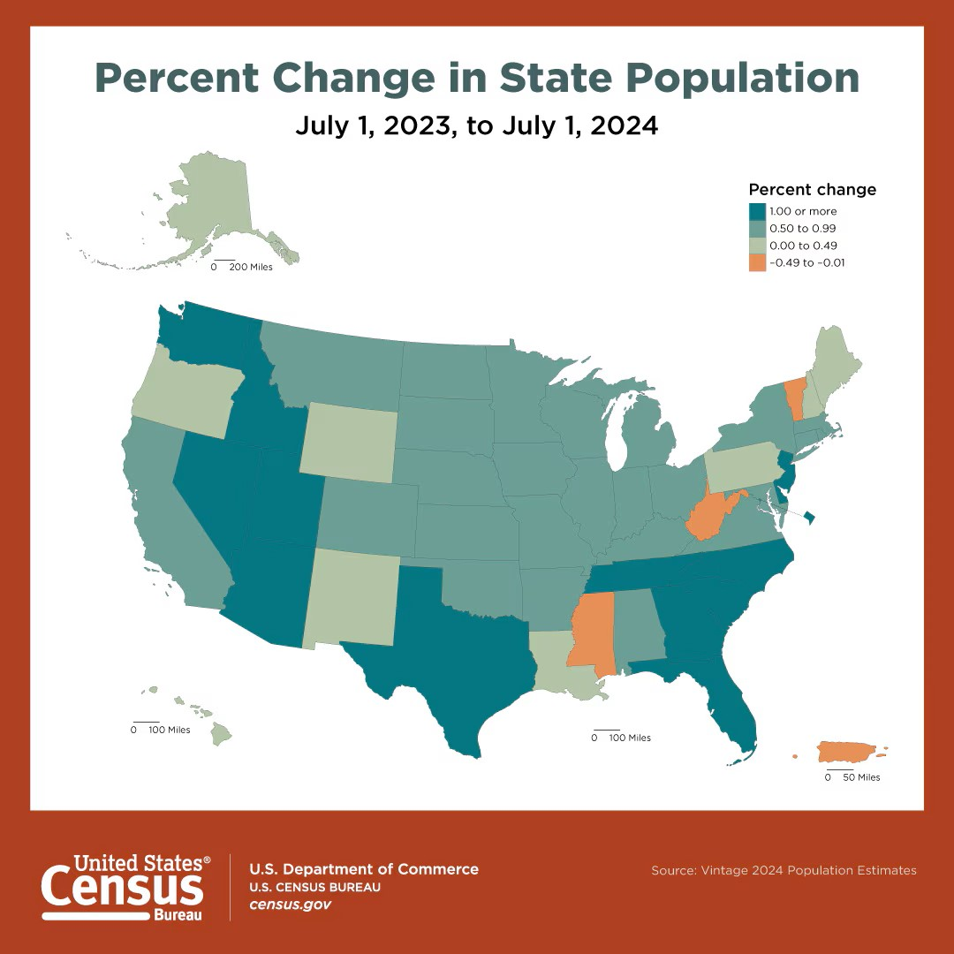
Population Growth by State: 2023 - 2024
Best in Texas, the Intermountain West and the South.
Notes:
Updated 12-19-24
https://www.census.gov/library/visualizations/2024/comm/percent-change-in-state-population.html
https://www.census.gov/newsroom/press-kits/2024/national-state-population-estimates.html

Slide 51
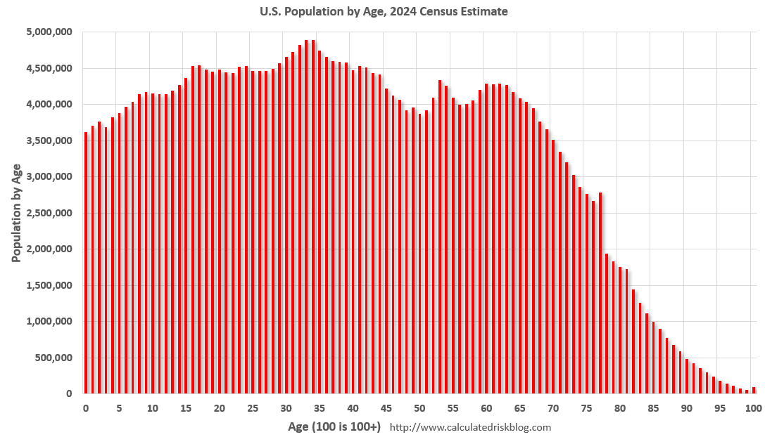
Demographics Are Good
Demand will be strong for years
Notes:
4-16-25. CalculatedRisk blog. (Millennials)

Slide 52
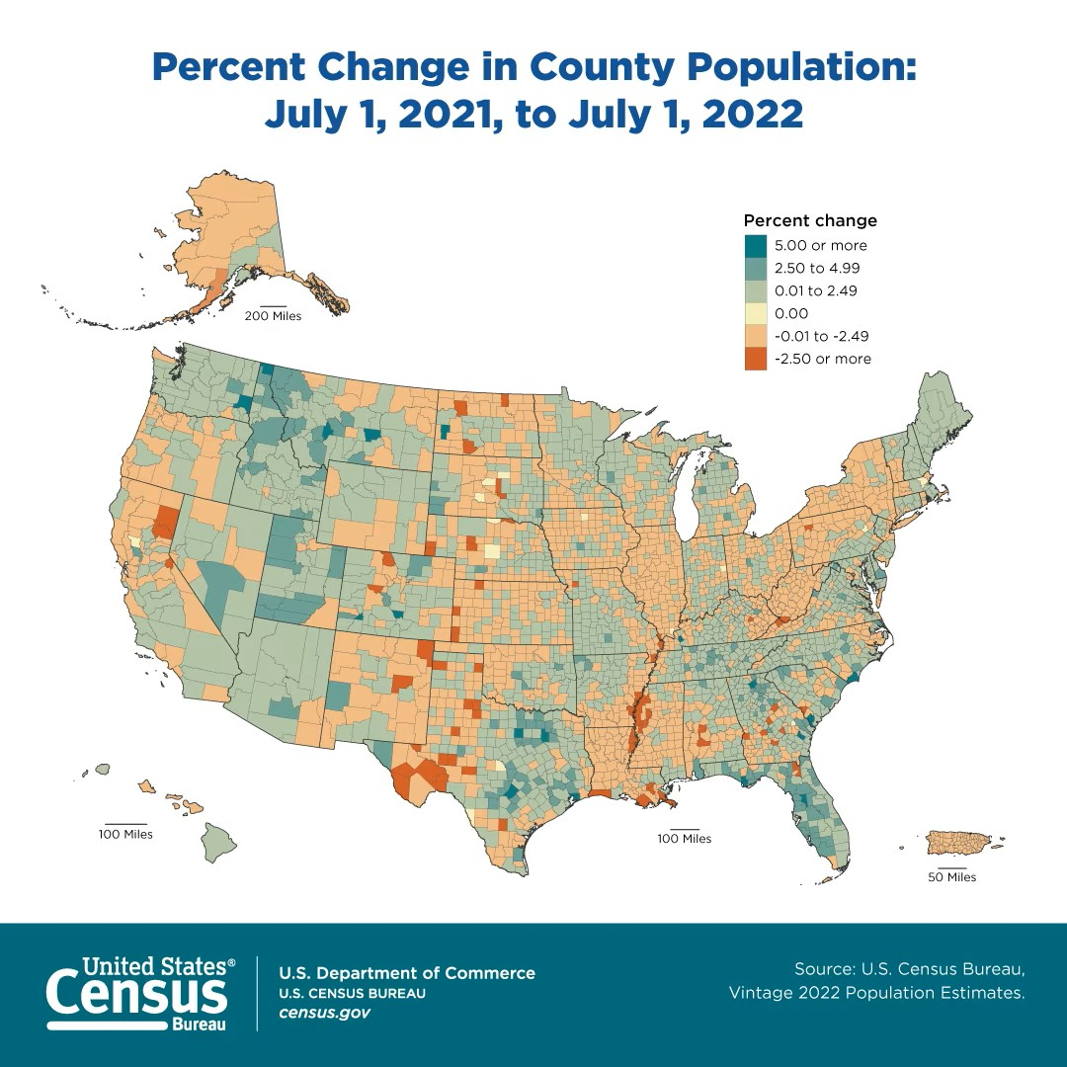
Population Growth by County: 2021-2022
Best all over the place. Pandemic related. Will it persist?
Notes:
Updated 3-30-23
https://www.census.gov/library/visualizations/2023/comm/percent-change-in-county-population.html

Slide 53
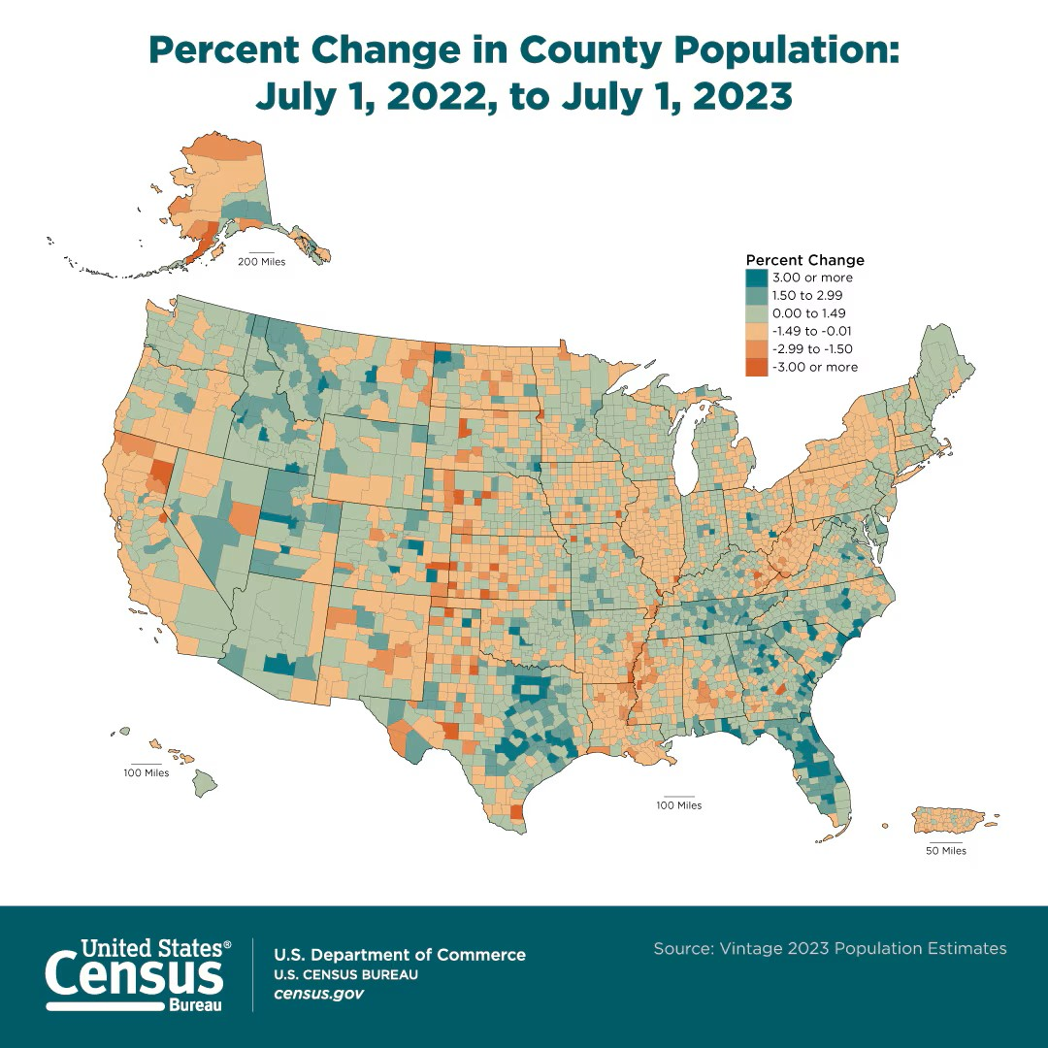
Population Growth by County: 2022-2023
Best all over the place. Pandemic related. Will it persist?
Notes:
Updated 3-14-24
https://www.census.gov/newsroom/press-releases/2024/population-estimates-more-counties-population-gains-2023.html

Slide 54
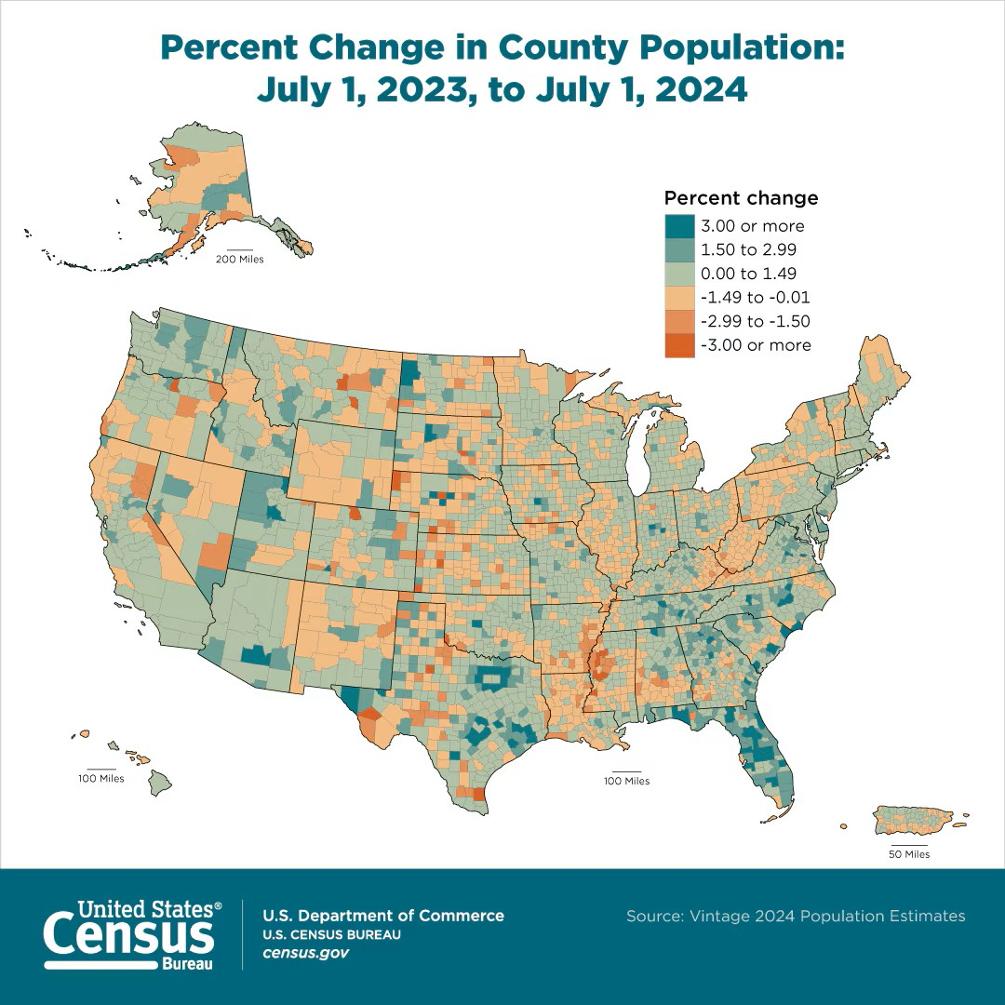
Population Growth by County: 2023-2024
Best all over the place. Pandemic related. Will it persist?
Notes:
Updated 3-12-25 (Percent change in County population)
https://www.census.gov/library/visualizations/2025/comm/percent-change-county-population.html

Slide 55
KEY TAKEAWAYS
1) 2025 might still be a decent year
2) The Fed will keep cutting rates
3) Job growth probably slows more
4) Inflation should rise slightly
5) Watch inflation and unemployment
Notes:
Updated 4-4-25

Slide 56
ANY QUESTIONS?
Elliot F. Eisenberg, Ph.D.
Cell: 202.306.2731
elliot@graphsandlaughs.net
www.econ70.com
Do you want to get my daily 70-word economics email?
Please give me your business card or text “bowtie” to 66866
Thank YOU all very very much!
@ECON70

